Slide 1
Pizza hut analysis

Slide 2
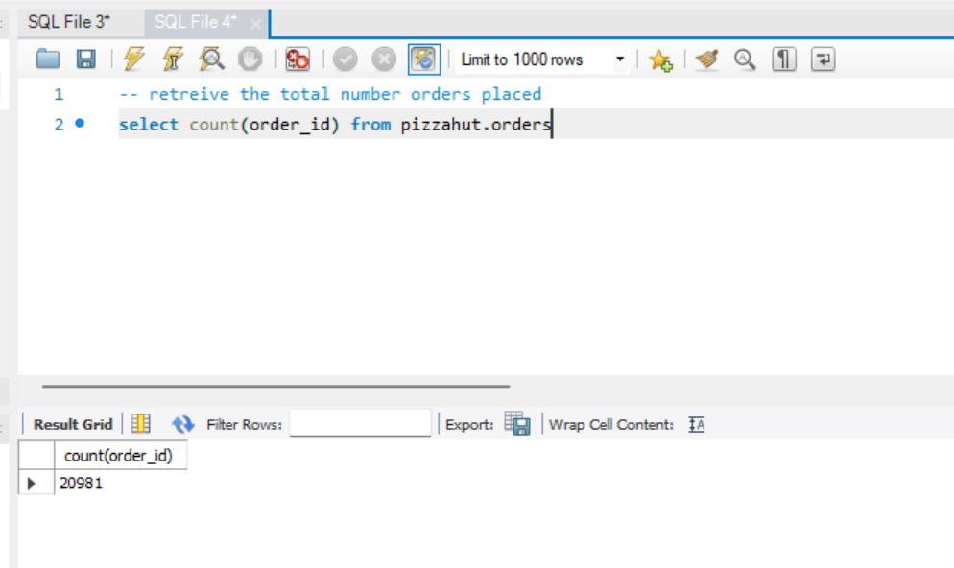
Q1 retrieve total number of customers

Slide 3
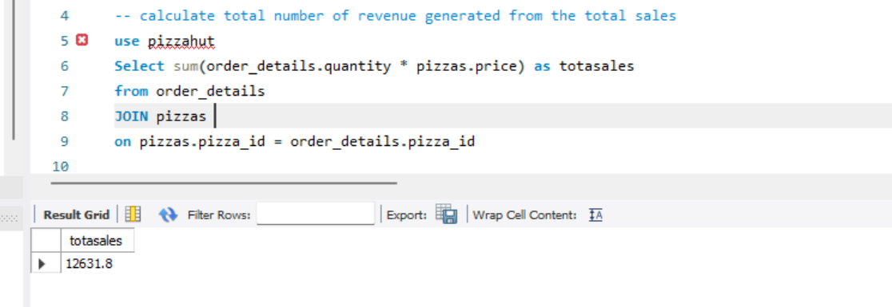
Q2 calculate the total number of revenue generated from total sales

Slide 4
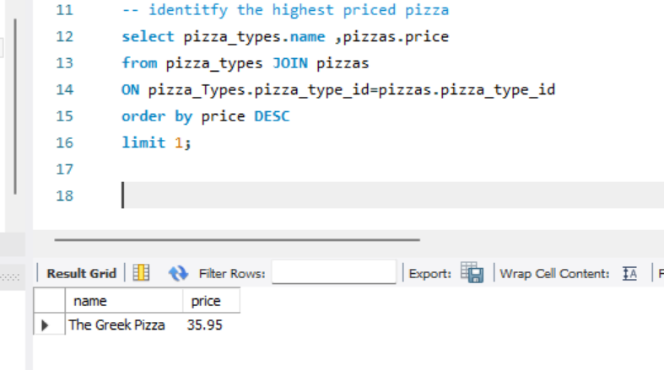
Q3 identify highest prices pizza

Slide 5
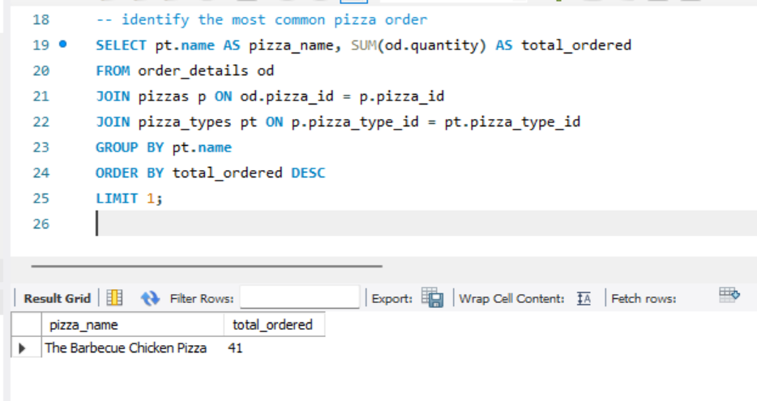
Q4 identify the most common pizza ordered

Slide 6
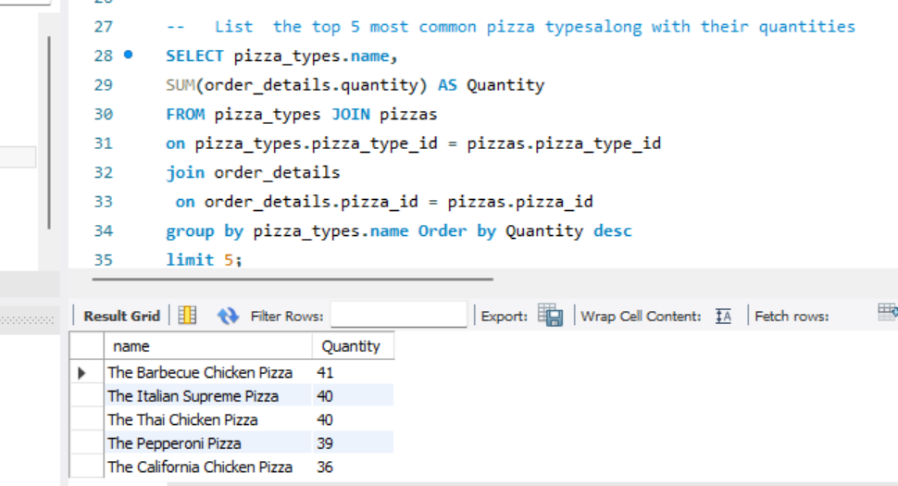
Q5 List the top 5 most common pizza typesalong with their quantities

Slide 7
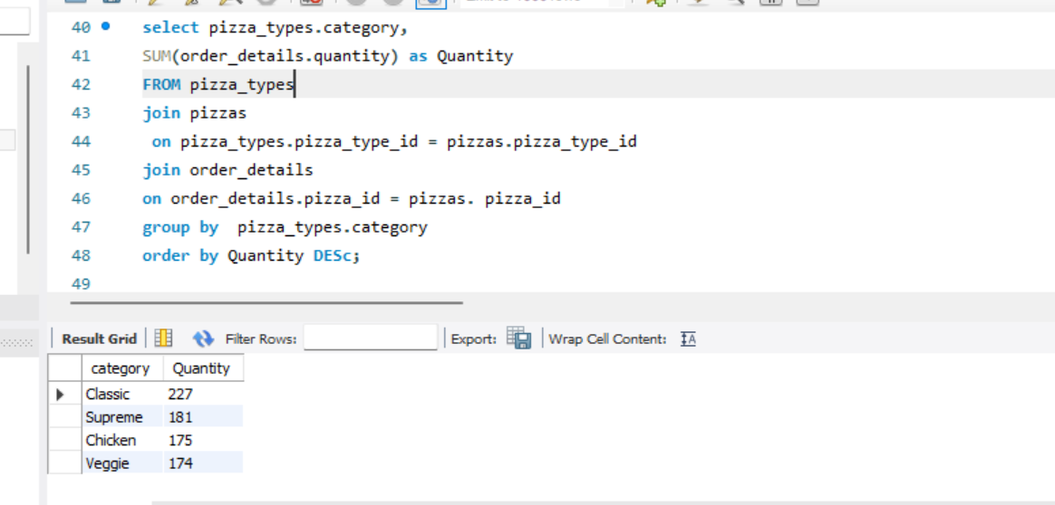
Q6 join the necessary table to find order quantity of each pizza category ordered

Slide 8
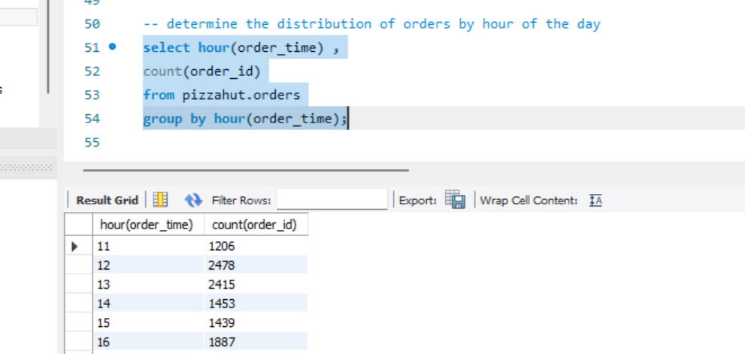
Q7 determine the distribution of orders by hour of the day

Slide 9
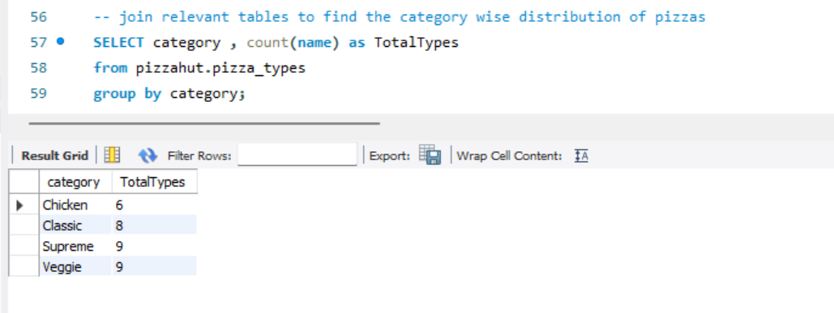
Q8 join relevant tables to find the category wise distribution of pizzas

Slide 10
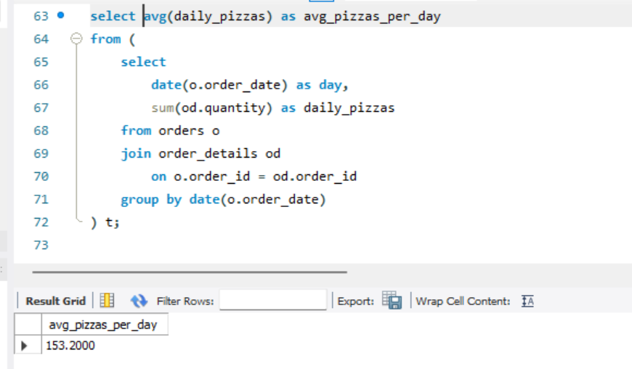
Q9 group the orders by date and calculate the average number of
pizzas ordered per day

Slide 11
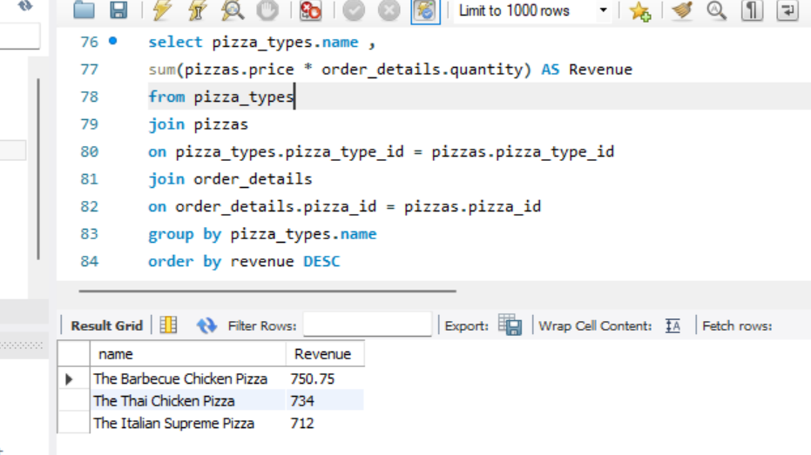
Q10 determine most 3 ordered pizza based on revenue

Slide 12
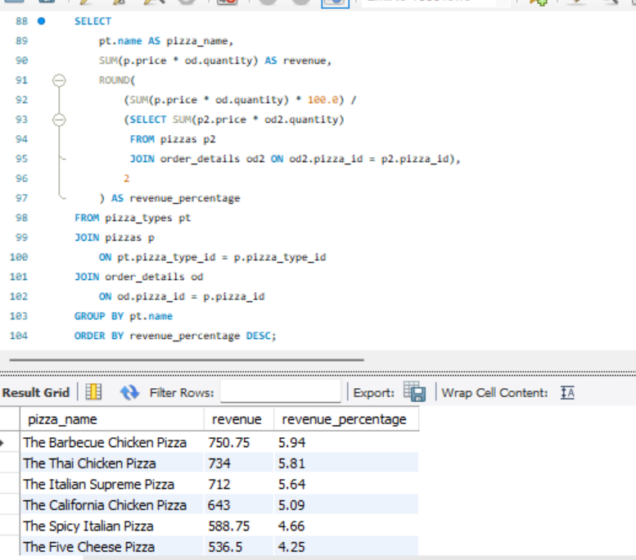
Q11 calculate the percentage contribution
of each pizza type to total revenue

Slide 13
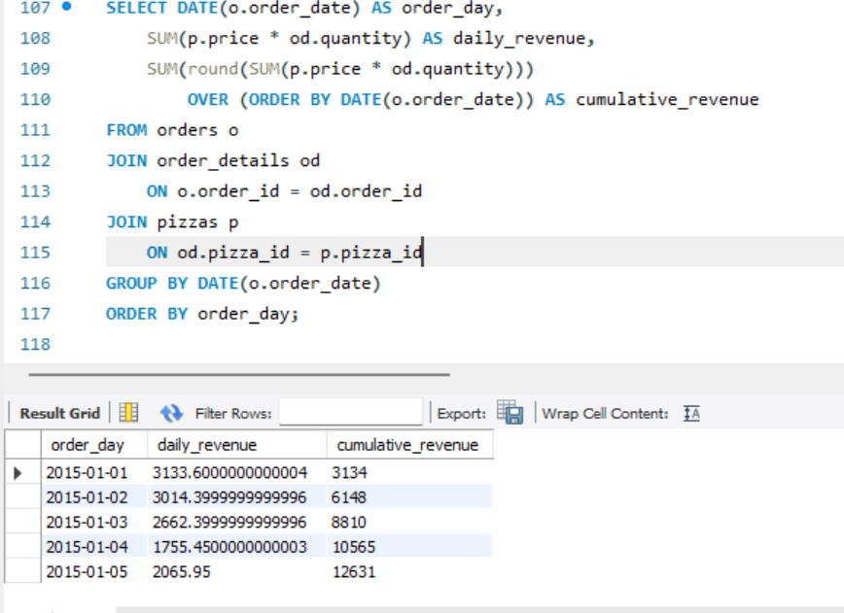
Q12 analyse the cumulative revenue generated over time

